Slide 1
RF Remote Labs Development:
October 13th, 2022

Slide 2
Overview of the Hardware and Laboratory Activities for 2-port VNA Measurements by Remote Access
Courses: (1) Radio Frequency Engineering (RF4), and (2) RF/Microwave Circuits and Systems (RF5)
Lab 1 – Filter Measure (RF4); requires one PCB (2-port device)
Lab 2 – Coupler Measure (RF5); requires three identical PCBs (4-port device)
First Implementation: Winter 2023, 20% (Formative)
Winter 2024, 20% (Summative)

Slide 3
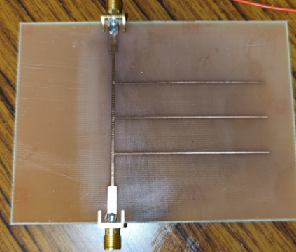
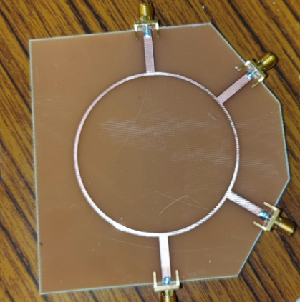
Student Perspective:
RF5 Lab – Coupler Measure; requires three identical PCB
(4-port passive structure, 180 degree hybrid coupler)
Required Measurement Output for the Students:
Given that we are measuring a 4-port PCB with a 2-port VNA and a switch, have to compromise and need 3 separate PCBs
Transmission Coefficients: S21, S41, S31
Reflection Coefficients: S11, S22, S33, S44
Output Data: real/imag, dB/phase
Ideally it would be good for students to easily record different phase differences; ex. Phase(S41) – Phase(S21) = 180 degrees (ideally), rather than calculating offline
RF4 Lab – Filter Measure; requires one PCB (2-port device)
Required Measurement Output for the Students:
Reflection Coefficients: S11, S22 (real/imag, dB/phase)
Transmission Coefficient: S21, S12 (real/imag, dB/phase)
Filter is a Stopband Filter (reflects apx. 0.65 GHz to 0.8 GHz, and this response is repeated at ~1.9 GHz)
Port1
Port2
Port4
Port1
Port2
Port3

Slide 4
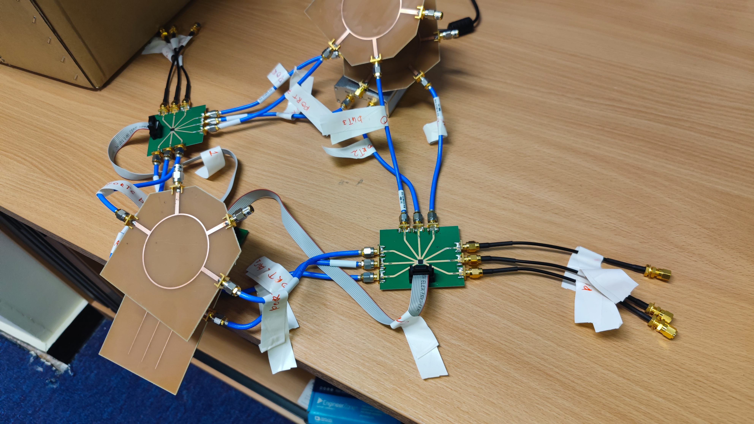
Overview of the Hardware Setup: all ports are marked.
Thru, filter s21 (DUT1), coupler s21 (DUT2), coupler S41 (DUT3), Coupler S31 isolation (DUT4)

Slide 5
Overview of the Hardware Setup
Ports 0 to ports 7
Switch 2
Ports 0 to ports 7
Switch 1
Switch Board #1
Switch Board #2

Slide 6
PLEASE BE GENTLE WITH THE CONNECTORS
I ASKED TECHNICIANS TO SOLDER THEM FROM BOTTOM TOO. PADS ARE EASY TO DETACH!
BENT CABLES – LESS FORCE TO CONNECTORS

Slide 7
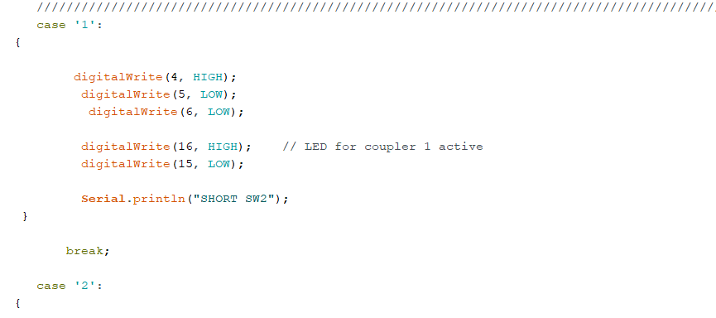
Code for Arduino – everything coded with the case statement
Type in with serial monitor

Slide 8
Commands:
1 – short switch 2 (port 2 of the VNA)
2- Open switch 2 (port 2 of the VNA)
3- Load switch 2 (port 2 of the VNA)
4 – short switch 1 (port 2 of the VNA)
5- Open switch 1 (port 2 of the VNA)
6- Load switch 1 (port 2 of the VNA)
7 – Thru (port 4 of switch 1 and port 3 of switch 2)

Slide 9
Commands:
8 – Middle DUT1 active (SW1 Port 5, SW2 port 2)
9 – Port 0 of SW2 is active (this is if we want to have another lab with reflection coefficient ONLY)
a – Port 1 of SW2 is active (this is if we want to have another lab with reflection coefficient ONLY)
b – Port 8 of SW2 is active (this is if we want to have another lab with reflection coefficient ONLY)
c – Port 0 of SW1 is active (this is if we want to have another lab with reflection coefficient ONLY)
d – Port 6 of SW1 is active (this is if we want to have another lab with reflection coefficient ONLY)
e – Port 7 of SW1 is active (this is if we want to have another lab with reflection coefficient ONLY)
f - Middle DUT2 active (SW1 Port 6, SW2 port 1)
g - DUT3 active (SW1 Port 7, SW2 port 0)
h - DUT3 active (SW0 Port 7, SW2 port 7)

Slide 10
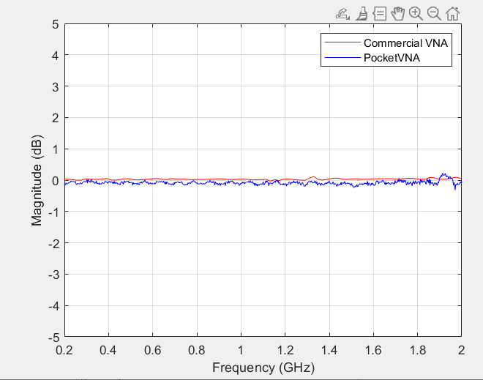
Test Output Results: THRU after calibration
Ideal Output: 0 dB

Slide 11
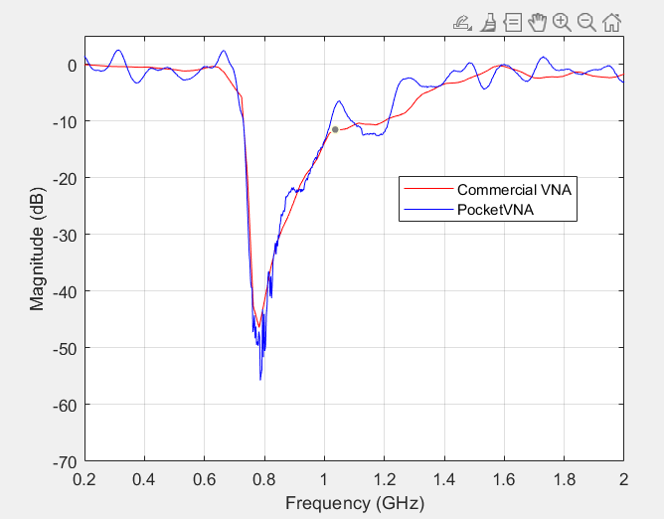
Test Output Results: DUT1 – bandstop filter
Simulated Output: < -25 dB @ 0.65 GHz

Slide 12
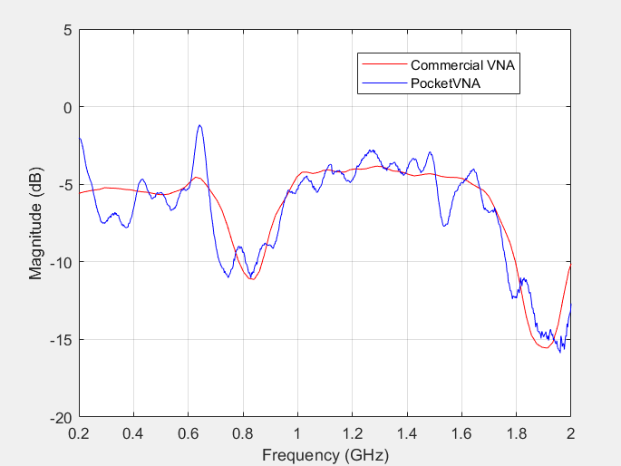
Test Output Results: DUT2 – Coupler S41
Simulated Output: - 3.5 dB, ~1.5 GHz
LOAD
LOAD

Slide 13
Test Output Results: DUT3 – 180 degree Hybrid Coupler, S21
Simulated Output: - 3.5 dB, ~1.5 GHz
LOAD
LOAD

Slide 14
Test Output Results: DUT4 – 180 degree Hybrid Coupler, S31 Isolation
Simulated Output: < -35 dB @1.4 GHz
LOAD
LOAD

Slide 15
All Test Output Results: Coupler S21, S31, and Isolation

Slide 16
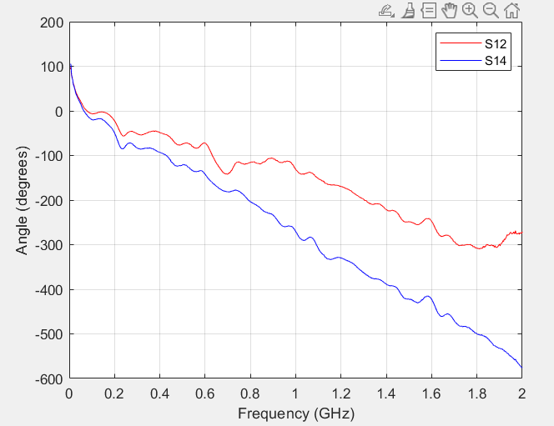
Test Output Results: Coupler S21 Phase and S41 Phase

Slide 17
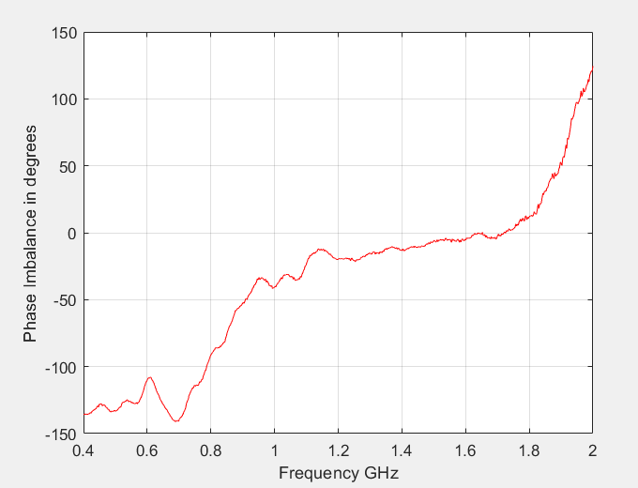
Phase imbalance of ports S21 and S41 (Ideally 0 degrees for the phase imbalance)
Phase of S21 minus phase of S41 should give a 180 degree phase difference
Imbalance Formula = unwrapped phase (Phase(S21)) - Phase(S41)) -180 (CHECK THE SIGN!)
Here 180 degree refers to the hybrid coupler response for ideal phase (i.e. 180 degrees).

